Slide 1


Privacy Best Practice for Casting

Slide 2

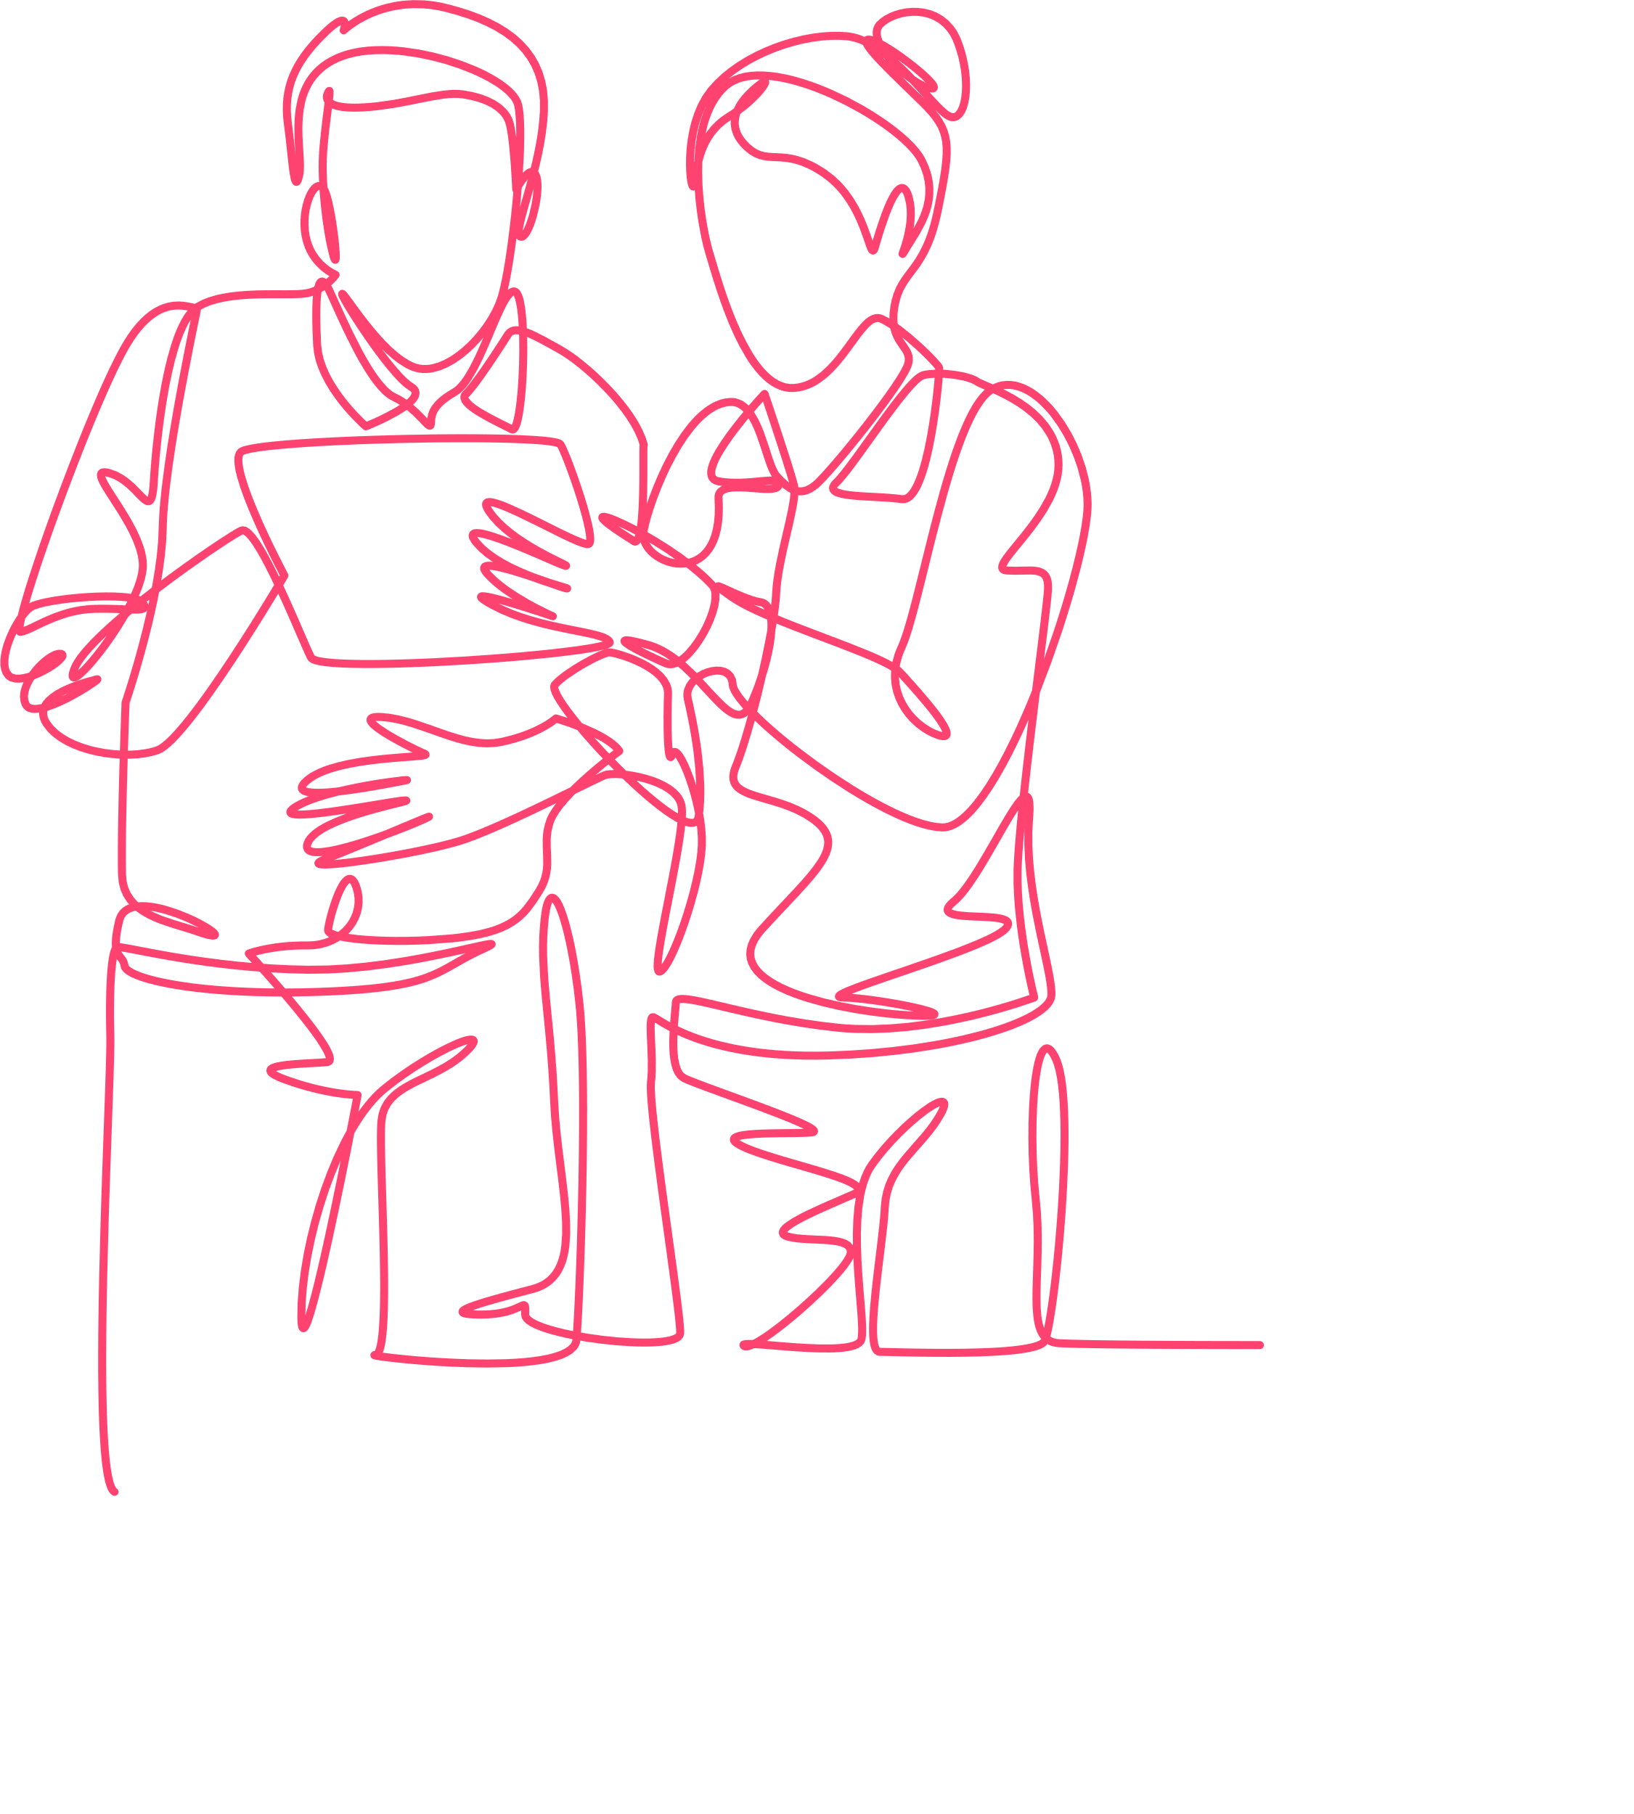

2
During production work on Banijay formats, you will come into contact with personal data pertaining to cast, (potential) participants and crew. It is important that all productions are done in compliance with privacy laws and with respect for the privacy of those who are part of our productions.
Please use the checklist and read this privacy manual to ensure compliance with privacy laws. In this document, we sometimes refer to the General Data Protection Regulation or GDPR, as this is the privacy legislation in the EEA, based on which we have drafted this Best Practice. However, if you are in a territory outside the EEA, this document will still be of use as it includes the minimum standards that we require for everyone who’s involved in casting for our shows.
If you have any questions, please contact your local legal department or the central compliance team (compliance@banijay.com).

Slide 3


3
Type of personal data
Confidentiality & security of personal data
Third party casting platforms
Determine what information you need from participants and at what phase of the casting process (please also see paragraph 2, and the Privacy Impact Sheet).
Only collect information that you really need for the production, don’t over-ask (please also see paragraph 2).
Determine (in consultation with the broadcaster) whether any psychological, physical, or background checks are needed and when. Before performing those checks, get in touch with the local legal department as this may have to be outsourced for legal reasons.
Determine whether a Data Protection Impact Assessment needs to be conducted (please also see paragraph 5).
All participant information is to be treated as strictly confidential and may not be disclosed to anyone in the production or crew unless on a need-to-know basis to the extent necessary to perform their job.
All participant information must be collected and stored securely. This means collected through a GDPR compliant online casting platform (such as Cast It Reach [formerly known as eTribez] or Short Audition) and stored in folders with restricted access, for example Box or Sharepoint (please also see paragraphs 3 and 8).
Minimize printing & never leave printed participant information lying around!
Securely destroy the information when it is no longer needed.
If using Internet of Things (IoT) devices, please check the IoT Security Requirements Policy.
It is recommended to set up the casting campaign in a GDPR compliant third-party casting platform, (please also see paragraph 3).
Never collect casting data from potential contributors via WhatsApp, or use Word documents or Excel spreadsheets. They are not secure and there is a significantly higher risk of third parties accessing the information.
Paperwork
Draft necessary paperwork, including participants’ agreements and tailored privacy policies informing participants which personal data you collect and what you do with that data (please also see paragraph 4 on privacy notices).
Children
If you work with children, please ensure you have parental consent & preferably, a chaperone.

Slide 4

4
1
Personal data
While working on productions you will come into contact with personal data pertaining to cast, (potential) participants and crew. Personal data is information relating to an identified or identifiable individual. Personal data includes a broad range of information including:
Name, address, email address, phone number, marital status, hobbies, family situation, etc.
“Sensitive data” includes information about an individual’s racial or ethnic origin, political opinion, religious beliefs, sexual orientation, sex life, health or biometric data, criminal records, or other data of a highly personal nature.
Information about children is also considered to be sensitive and we must take extra care to ensure confidentiality and security. Please click here for a Privacy Impact Sheet that provides guidance on dealing with different categories of personal data.

Slide 5

5
2
Collection or and access to personal information
You and the colleagues and freelancers working with you may have access to or will routinely acquire (sensitive) personal data from many sources and in many forms, including:
Past, current and future employees, contributors, suppliers and contractors (including via invoices, purchase orders, lists of employees, CV’s, employment agreements and employee references).
In letters, correspondence, call logs.
Program treatments, running orders and call sheets.
Background checks and/or disclosure & barring service checks.
Medical records.
CCTV footage.
Contributor agreements, release forms and application forms.
Bank statements.
When collecting personal data
Limit the information collected to what is actually needed. For example, it is unlikely that you would need information regarding a contributor’s sexual history, unless it is relevant to the program.
Tell the individual why you are collecting their personal data (the purpose), and any additional information necessary if specific circumstances require it, by means of a privacy notice (please also see paragraph 5).

Slide 6

6
3
Third-party casting platform
At Banijay, we make use of one of the contracted casting platforms, such as Cast It Reach (formerly known as eTribez) and Short Audition, for the secure collecting and storage of personal data of contestants. These platforms offer a secure and GDPR compliant solution. If you are not using Cast It Reach or Short Audition, please ensure casting is done in a privacy & security compliant manner. You can always get in touch with your local legal department if you need assistance.

Slide 7

7
4
Personal data
A privacy notice is a statement that identifies the party collecting information, what it will be used for (the purpose) and details of any third parties the personal data is going to be shared with. When collecting personal data for a show, you must send a privacy notice to the persons that are providing their personal data. Please click here to view an example template privacy notice. Under the GDPR, privacy notices are required to include some very specific information. Therefore, please get in touch with your local legal team to make sure that the privacy notice is complete and accurate.

Slide 8


8
5
Data protection impact assessment
Conducting a Data Protection Impact Assessment (DPIA) is required if the activity you are doing with the personal data presents a high risk to individuals. Casting can be considered high risk if, for example, you:
Collect a large amount of personal data from a large number of potential participants.
Collect sensitive data from potential participants.
Collect data from vulnerable data subjects such as refugees, children, patients, etc.
Use automated processing, including the use of profiling, to base decisions on.
Match or combine data sets.
Please contact the local legal department to determine
if a DPIA is required.
When in doubt, it’s always good practice to conduct a DPIA.

Slide 9

9
6
Recommended practices for security of personal information
We are required to take active measures to ensure the security of personal data we hold and to actively consider if we are permitted to retain this personal data. We must regularly review how we store all personal data, including for those individuals whose personal data is collected during the course of making the program and assess whether the security measures in place are adequate or can be improved. If you will be using Internet of Things (IoT) or connected devices, please click here to view the IoT Security Requirements Policy.

Slide 10
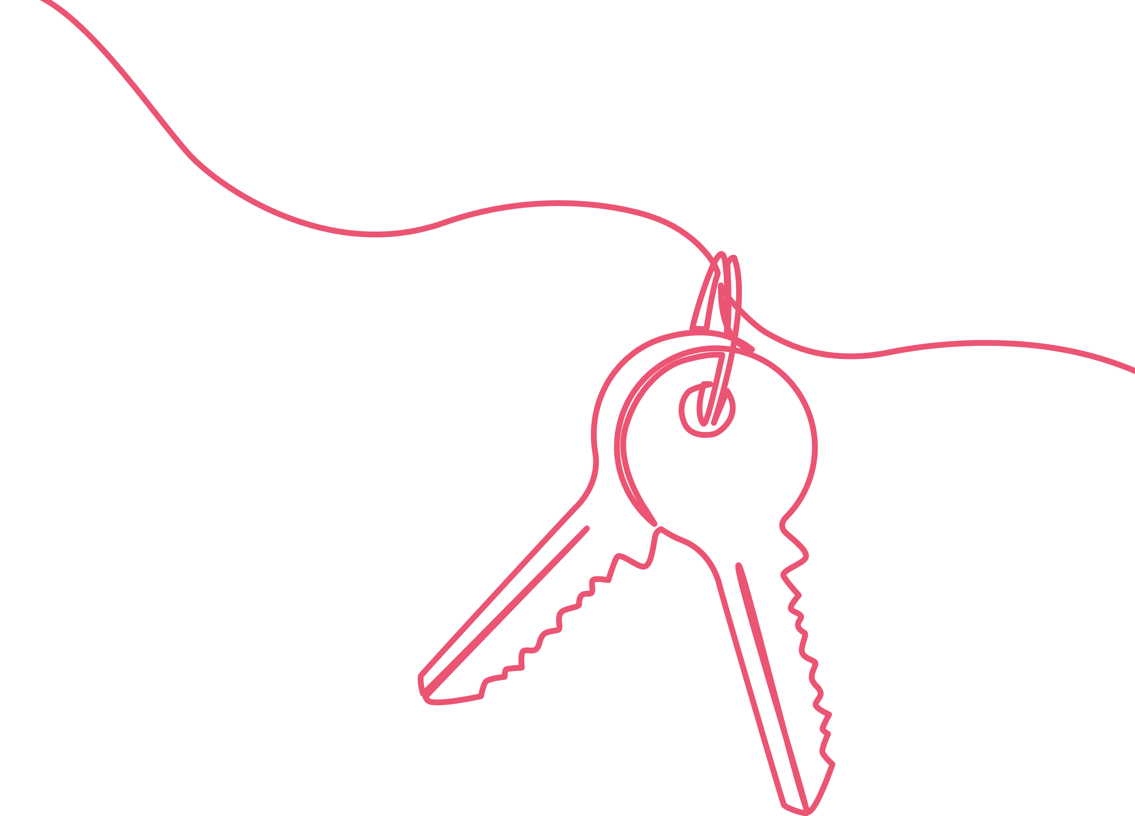
10
Suggestions for the security of (hard copies of) personal data
Suggestions for security of personal data in digital form
Keep hard copies in locked cabinets and/or in a secure storage on or off the site.
Position computer screens, notice boards and white boards away from windows/public view to prevent accidental disclosures of personal data.
Give guidance to staff on the protection, return and/ or destruction of documents, memory sticks and/ or DVDs that need to be taken off the premises.
When off site, provide for secure storage of production paperwork, call sheets, release forms to ensure documentation is not left lying around.
Consider sending or sharing electronic copies instead of hard copies.
Do not leave documents on the photocopier, scanner or fax machine.
Ensure shredders and/or “security safe” recycling bins/boxes are readily available for disposing documents containing personal data.
We recommend that someone on the production team is made responsible for this purpose.
Don’t share personal data over email or save copies of personal data on your personal computer. Use cloud based/collaboration tool storage systems that are approved by the Banijay IT department. These include Cast It Reach or Short Audition for the casting, and Box and Sharepoint for data storage and sharing.
Use suitable password protection on any computers, laptops, computer discs, memory sticks, etc. Please contact the IT department for guidance.
Limit access to personal data to only those who actually require it.
When staff leave, make sure to “off-board” them, which includes obliging them to leave behind and/or delete all confidential information and/or personal data that does not need to be retained.
Ensure any rented computers or other data storage equipment are wiped before returning to the rental company.

Slide 11


11
7
End of production/ retention
We are required to take reasonable steps to destroy or de-identify personal data and other confidential information we hold once we no longer need it. Therefore:
Make sure to have retention schedules in place which are followed to lower the risk of misuse and loss of, interference with and unauthorized access to information.
On closedown of a production, senior staff, together with legal should review what personal data can be legitimately retained or must be destroyed.
For example, records of quiz show applicants who are not in the final program should be destroyed unless they have given permission for the records to be kept for future series or other shows or there is another legitimate business or legal reason to retain them (e.g. they had an accident at the audition and it is required for health and safety reasons), but the records of an applicant who doesn’t make the final cut may still need to be held for a limited time e.g. for auditing purposes.
Please reach out to your local legal team for guidance on data retention periods and best practices.

Slide 12

12
8
Engaging a third-party for processing personal data or sharing personal data with a third-party
If you are using a third-party to process data on your behalf or if you share personal data with another organization, you must first check with your manager who may then refer you to IT and the local legal department. They can assess whether the purpose for the sharing of personal data is valid, and that the other organization has appropriate data security measures in place to ensure the security of the personal data. In this case it will also be necessary to enter into a Data Processing Agreement with them.
If you transfer data to a broadcaster or any other third-party located outside of the EEA, there are some specific requirements regarding the legal documentation. In such case, please always contact your local legal department.

Slide 13

13
9
What if you become aware of a breach of security
or an unauthorised disclosure/data breach?
If you think you may have lost confidential information or personal data or there has been unauthorized access or disclosure of personal data notify your line manager ASAP. They will inform the IT department and the local legal team; or, if you can’t reach them, notify the central compliance team by sending an email to: compliance@banijay.com.

Slide 14
14
Annex
Privacy principles
Helpful terms
At Banijay, we adopt the GDPR’s following main principles when it comes to handling personal data:
We always process personal data fairly, lawfully and transparently.
We only collect and process personal data for specified, explicit and legitimate purposes.
Personal data should be accurate and, where necessary, kept up to date.
We don’t keep personal data for any longer than necessary for the purpose for which we collected it.
The personal data we collect should be adequate, relevant and limited to what is necessary for the purpose for which it is collected.
We protect personal data against unauthorised or unlawful processing and accidental loss, destruction or damage.
The principles are general guidelines that we must always follow when handling personal data.
Personal data includes any data which relates to a living individual who can be identified, directly or indirectly, from that data. Examples of personal data are a person’s name, address, date of birth, photographs, telephone numbers, email addresses, next of kin, passport details and bank and payroll information. These examples are not exhaustive.
Sensitive personal data, also known as “special categories of data”, includes data that relates to an individual’s racial or ethnic origin, religious or philosophical beliefs, political opinions, trade union membership, genetic data, biometric data in order to uniquely identify a person, physical or mental matters concerning health, sexual orientation, sex life and criminal records, offences or alleged offences. This may also include data which may more generally be considered as increasing the possible risk to the rights and freedoms of individuals, such as electronic communication data, location data, financial data.
Processing means any operation performed on personal data, whether manually or by automated means. It includes collection, recording, organisation, structuring, storage, adaptation or alteration, retrieval, consultation, use, disclosure by transmission, dissemination or otherwise making available, alignment or combination, restriction, erasure or destruction.
Consent refers to any freely given, specific and informed indication of the wishes of an individual, by which they agree to personal data relating to him/her being processed.
Data breach means a breach of security leading to the accidental or unlawful destruction, loss, alteration, unauthorized disclosure of, or access to, personal data transmitted, stored or otherwise processed.

